Slide 1
Software Design

Slide 2

Introduction
Design phase transforms SRS document:
  into a form easily implementable in some programming language.
SRS Document
Design Documents
Design Activities

Slide 3
Items Designed During Design Phase
1. module structure,
2. control relationship among the modules
3. interface among different modules,
  data items exchanged among different modules,
4. data structures of individual modules,
5. algorithms for individual modules.

Slide 4
Module Structure

Slide 5
Introduction
A module consists of:
  1. several functions
  2. associated data structures.
D1 ..
D2 ..
Data
D3 ..
F1 ..
Functions
F2 ..
F3 ..
F4 ..
F5 ..

Slide 6
Introduction
Design activities are usually classified into two stages:
  1. preliminary (or high-level) design
  2. detailed design.

Slide 7
High-level design
Identify:
  1. modules
  2. control relationships among modules
  3. interfaces among modules.
d1
d2
d3
d1
d4

Slide 8
High-level design
The outcome of high-level design:
  program structure (or software architecture).

Slide 9
Detailed design
For each module, design:
  1. data structure
  2. algorithms
Outcome of detailed design:
  module specification.

Slide 10
What Is Good Software Design?
Should implement all functionalities of the system correctly.
Should be easily understandable.
Should be efficient.
Should be easily able to change,
  i.e. easily maintainable.

Slide 11
What Is Good Software Design?
Understandability of a design is a major issue:
  determines goodness of design:
  a design that is easy to understand: also easy to maintain and change.

Slide 12
What Is Good Software Design?
Unless a design is easy to understand, tremendous effort needed to maintain it.
  We already know that about 60% effort is spent in maintenance.
If the software is not easy to understand:
  maintenance effort would increase many times.

Slide 13
Understandability
Use consistent and meaningful names
  for various design components,
Design solution should consist of:
  a cleanly decomposed set of modules (modularity),
Different modules should be neatly arranged in a hierarchy:
  in a neat tree-like diagram.

Slide 14
Modularity
Modularity is a fundamental attributes of any good design.
  Decomposition of a problem cleanly into modules:
  1. Modules are almost independent of each other
  2. divide and conquer principle.

Slide 15
Modularity
If modules are independent:
  modules can be understood separately.
  reduces the complexity greatly.
  To understand why this is so,
    remember that it is very difficult to break a bunch of sticks but very easy to break the sticks individually.

Slide 16
Example of Cleanly and Non-cleanly Decomposed Modules

Slide 17
Modularity
In technical terms, modules should display:
  1. high cohesion
  2. low coupling.

Slide 18
Modularity
Neat arrangement of modules in a hierarchy means:
  low fan-out
  Fan-out: a measure of the number of modules directly controlled by given module.
  2. abstraction

Slide 19
Cohesion and Coupling
Cohesion is a measure of:
  functional strength of a module.
  A cohesive module performs a single task or function.
Coupling between two modules:
  a measure of the degree of interdependence or interaction between the two modules.

Slide 20
Cohesion and Coupling
A module having high cohesion and low coupling:
  functionally independent of other modules:
    A functionally independent module has minimal interaction with other modules.

Slide 21
Advantages of Functional Independence
Better understandability and good design:
Complexity of design is reduced,
Different modules easily understood in isolation:
modules are independent

Slide 22
Advantages of Functional Independence
Functional independence reduces error propagation.
  degree of interaction between modules is low.
  an error existing in one module does not directly affect other modules.
Reuse of modules is possible.

Slide 23
Classification of Cohesiveness
functional
sequential
communicational
Degree of
cohesion
procedural
temporal
logical
coincidental

Slide 24
Coincidental cohesion
The module performs a set of tasks:
  which relate to each other very loosely, if at all.
    the module contains a random collection of functions.
    functions have been put in the module out of pure coincidence without any thought or design.

Slide 25
Logical cohesion
All elements of the module perform similar operations:
e.g. error handling, data input, data output, etc.

Slide 26
Temporal cohesion
The module contains tasks that are related by the fact that all the tasks must be executed in the same time span.

Slide 27
Procedural cohesion
If the set of functions of the module all part of a procedure (algorithm) in which certain sequence of steps have to be carried out in a certain order for achieving an objective,
    e.g. the algorithm for decoding a message.

Slide 28
Communicational cohesion
If All functions of the module Refer to the same data structure,
Example:
  the set of functions defined on an array or a stack.

Slide 29
Sequential cohesion
If the Elements of a module forms different parts of a sequence, output from one element of the sequence is input to the next.
  Example:
sort
search
display

Slide 30
Functional cohesion
If the Different elements of a module cooperate to achieve a single function.

Slide 31
Coupling
Coupling indicates:
  how closely two modules interact or how interdependent they are.
  The degree of coupling between two modules depends on their interface complexity.

Slide 32
Classes of coupling
data
stamp
control
Degree of
coupling
common
content

Slide 33
Data coupling
Two modules are data coupled,
  if they communicate by an elementary data item that is passed as a parameter between the two, eg an integer, a floa, character etc.

Slide 34
Stamp coupling
Two modules are stamp coupled,
  if they communicate via a composite data item:
    such as a record in PASCAL
    or a structure in C.

Slide 35
Control coupling
It exists between two modules.
If Data from one module is used to direct order of instruction execution in another.
Example of control coupling:
  a flag set in one module and tested in another module.

Slide 36
Common Coupling
Two modules are common coupled, if they share some global data items.

Slide 37
Content coupling
Content coupling exists between two modules:
  if they share code,
  e.g, branching from one module into another module.
The degree of coupling increases
  from data coupling to content coupling.

Slide 38
Neat Hierarchy
Control hierarchy represents organization of modules. control hierarchy is also called program structure.

Slide 39
Characteristics of Module Structure
Depth:
  number of levels of control
Width:
  overall span of control.
Fan-out:
  a measure of the number of modules directly controlled by given module.

Slide 40
Characteristics of Module Structure
Fan-in:
  indicates how many modules directly invoke a given module.
  High fan-in represents code reuse and is in general encouraged.

Slide 41
Module Structure
Fan out=2
Fan out=1
Fan in=2
Fan out=0

Slide 42
Goodness of Design
A design having modules:
  with high fan-out numbers is not a good design:
  a module having high fan-out lacks cohesion.

Slide 43
Visibility and Layering
A module A is said to be visible by another module B,
  if A directly or indirectly calls B.
The layering principle requires
  modules at a layer can call only the modules immediately below it.

Slide 44
Bad Design

Slide 45
Abstraction
The principle of abstraction requires:
  lower-level modules do not invoke functions of higher level modules.
  Also known as layered design.

Slide 46
High-level Design
High-level design maps functions into modules {fi} {mj} such that:
  Each module has high cohesion
  Coupling among modules is as low as possible
  Modules are organized in a neat hierarchy

Slide 47
Design Approaches
Two fundamentally different software design approaches:
  Function-oriented design
  Object-oriented design

Slide 48
Function-Oriented Design
A system is looked upon as something
  that performs a set of functions.
Starting at this high-level view of the system:
  each function is successively refined into more detailed functions.
  Functions are mapped to a module structure.

Slide 49
Function-Oriented Design
Each subfunction:
split into more detailed subfunctions and so on.

Slide 50
Object-Oriented Design
System is viewed as a collection of objects (i.e. entities).
each object manages its own state information.

Slide 51
Object-Oriented Design Example
Library Automation Software:
  each library member is a separate object with its own data and functions.
  Functions defined for one object:
    cannot directly refer to or change data of other objects.

Slide 52
Object-Oriented Design
Objects have their own internal data:
  defines their state.
Similar objects constitute a class.
  each object is a member of some class.
  Classes may inherit features from a super class.
Conceptually, objects communicate by message passing.

Slide 53
Object-Oriented versus Function-Oriented Design
Unlike function-oriented design,
  in OOD the basic abstraction is not functions such as “sort”, “display”, “track”, etc.,
  but real-world entities such as “employee”, “picture”, “machine”, “radar system”, etc.

Slide 54
Object-Oriented versus Function-Oriented Design
In OOD:
  software is not developed by designing functions such as:
    1. update-employee-record,
    2. get-employee-address, etc.
  but by designing objects such as:
    1. employees,
    2. departments, etc.

Slide 55
Summary
We characterized the features of a good software design by introducing the concepts of:
  fan-in, fan-out,
  cohesion, coupling,
  abstraction, etc.

Slide 56
Summary
Two fundamentally different approaches to software design:
  function-oriented approach
  object-oriented approach

Slide 57
Review of last lecture
There are two fundamentally different approaches to software design:
  function-oriented approach
  object-oriented approach
We looked at the essential philosophy of these two approaches:
  the approaches are not competing but complementary approaches.

Slide 58
Introduction
Function-oriented design techniques are very popular:
  currently in use in many software development organizations.
Function-oriented design techniques:
  start with the functional requirements specified in the SRS document.

Slide 59
Introduction
During the design process:
  high-level functions are successively decomposed:
    into more detailed functions.
  finally the detailed functions are mapped to a module structure.

Slide 60
Introduction
Successive decomposition of high-level functions:
  into more detailed functions.
  Technically known as top-down decomposition.

Slide 61
Introduction
SA/SD methodology:
  has essential features of several important function-oriented design methodologies ---
    if you need to use any specific design methodology later on,
    you can do so easily with small additional effort.

Slide 62
Overview of SA/SD Methodology
SA/SD methodology consists of two distinct activities:
  Structured Analysis (SA)
  Structured Design (SD)
During structured analysis:
  functional decomposition takes place.
During structured design:
  module structure is formalized.

Slide 63
Functional decomposition
Each function is analyzed:
  hierarchically decomposed into more detailed functions.
  simultaneous decomposition of high-level data
    into more detailed data.

Slide 64
Structured analysis
Transforms a textual problem description into a graphic model.
  done using data flow diagrams (DFDs).
  DFDs graphically represent the results of structured analysis.

Slide 65
Structured design
All the functions represented in the DFD:
  mapped to a module structure.
The module structure:
  also called as the software architecture:

Slide 66
Detailed Design
Software architecture:
  refined through detailed design.
  Detailed design can be directly implemented:
    using a conventional programming language.

Slide 67
Structured Analysis vs. Structured Design
Purpose of structured analysis:
  capture the detailed structure of the system as the user views it.
Purpose of structured design:
  arrive at a form that is suitable for implementation in some programming language.

Slide 68
Structured Analysis vs. Structured Design
The results of structured analysis can be easily understood even by ordinary customers:
  does not require computer knowledge
  directly represents customer’s perception of the problem
  uses customer’s terminology for naming different functions and data.
The results of structured analysis can be reviewed by customers:
  to check whether it captures all their requirements.

Slide 69
Structured Analysis
Based on principles of:
  Top-down decomposition approach.
  Divide and conquer principle:
    each function is considered individually (i.e. isolated from other functions)
    decompose functions totally disregarding what happens in other functions.
  Graphical representation of results using
    data flow diagrams (or bubble charts).

Slide 70
Data flow diagrams
DFD is an elegant modelling technique:
  useful not only to represent the results of structured analysis
  applicable to other areas also:
    e.g. for showing the flow of documents or items in an organization,
DFD technique is very popular because
  it is simple to understand and use.

Slide 71
Data flow diagram
DFD is a hierarchical graphical model:
  shows the different functions (or processes) of the system and
  data interchange among the processes.

Slide 72
DFD Concepts
It is useful to consider each function as a processing station:
  each function consumes some input data and
  produces some output data.

Slide 73

Data Flow Model of a Car Assembly Unit
Engine Store
Door Store
Chassis with Engine
Partly Assembled Car
Fit
Engine
Fit
Doors
Fit
Wheels
Paint and
Test
Assembled Car
Car
Chassis Store
Wheel Store

Slide 74
Data Flow Diagrams (DFDs)
A DFD model:
  uses limited types of symbols.
  simple set of rules
  easy to understand:
    it is a hierarchical model.

Slide 75
Hierarchical model
Human mind can easily understand any hierarchical model:
  in a hierarchical model:
    we start with a very simple and abstract model of a system,
    details are slowly introduced through the hierarchies.

Slide 76
Hierarchical Model

Slide 77
Data Flow Diagrams (DFDs)
Primitive Symbols Used for Constructing DFDs:

Slide 78
External Entity Symbol
Represented by a rectangle
External entities are real
physical entities:
  input data to the system or
  consume data produced by the system.
  Sometimes external entities are called terminator, source, or sink.
Librarian

Slide 79
Function Symbol
A function such as “search-book” is represented using a circle:
  This symbol is called a
  process or bubble or transform.
  Bubbles are annotated with corresponding function names.
  Functions represent some activity:
    function names should be verbs.
search-book

Slide 80
Data Flow Symbol
A directed arc or line.
  represents data flow in the direction of the arrow.
  Data flow symbols are annotated with names of data they carry.
book-name

Slide 81
Data Store Symbol
Represents a logical file:
  A logical file can be:
    a data structure
    a physical file on disk.
  Each data store is connected to a process:
    by means of a data flow symbol.
book-details

Slide 82
Data Store Symbol
Direction of data flow arrow:
  shows whether data is being read
  from or written into it.
An arrow into or out of a data store:
  implicitly represents the entire data of the data store
  arrows connecting to a data store need not be annotated with any data name.
find-book
Books

Slide 83
Synchronous operation
If two bubbles are directly connected by a data flow arrow:
  they are synchronous
Read-numbers
0.1
number
Validate-numbers
0.2
Valid number
Data-items

Slide 84
Asynchronous operation
If two bubbles are connected via a data store:
  they are not synchronous.
Read-numbers
0.1
Validate-numbers
0.2
numbers
Valid number
Data-items

Slide 85
Yourdon's vs. Gane Sarson Notations
The notations that we would be following are closer to the Yourdon's notations
You may sometimes find notations in books that are slightly different
  For example, the data store may look like a box with one end closed

Slide 86
How is Structured Analysis Performed?
Initially represent the software at the most abstract level:
  called the context diagram.
  the entire system is represented as a single bubble,
  this bubble is labelled according to the main function of the system.

Slide 87
Tic-tac-toe: Context Diagram
Tic-tac-toe software
display
move
Human Player

Slide 88
Context Diagram
A context diagram shows:
  data input to the system,
  output data generated by the system,
  external entities.

Slide 89
Context Diagram
Context diagram captures:
  various entities external to the system and interacting with it.
  data flow occurring between the system and the external entities.
The context diagram is also called as the level 0 DFD.

Slide 90
Context Diagram
Context diagram
  establishes the context of the system, i.e.
  represents:
    Data sources
    Data sinks.

Slide 91
Level 1 DFD
Examine the SRS document:
  Represent each high-level function as a bubble.
  Represent data input to every high-level function.
  Represent data output from every high-level function.

Slide 92
Higher level DFDs
Each high-level function is separately decomposed into subfunctions:
  identify the subfunctions of the function
  identify the data input to each subfunction
  identify the data output from each subfunction
These are represented as DFDs.

Slide 93
Decomposition
Decomposition of a bubble:
  also called factoring or exploding.
Each bubble is decomposed to
  between 3 to 7 bubbles.

Slide 94
Decomposition
Too few bubbles make decomposition superfluous:
  if a bubble is decomposed to just one or two bubbles:
    then this decomposition is redundant.

Slide 95
Decomposition
Too many bubbles:
  more than 7 bubbles at any level of a DFD
  make the DFD model hard to understand.

Slide 96
Decompose how long?
Decomposition of a bubble should be carried on until:
  a level at which the function of the bubble can be described using a simple algorithm.

Slide 97
Example 1: RMS Calculating Software
Consider a software called RMS calculating software:
  reads three integers in the range of -1000 and +1000
  finds out the root mean square (rms) of the three input numbers
  displays the result.

Slide 98
Example 1: RMS Calculating Software
The context diagram is simple to develop:
  The system accepts 3 integers from the user
  returns the result to him.

Slide 99
Example 1: RMS Calculating Software
Data-items
Compute- RMS
0
User
result
Context Diagram

Slide 100
Example 1: RMS Calculating Software
From a cursory analysis of the problem description:
  we can see that the system needs to perform several things.

Slide 101
Example 1: RMS Calculating Software
Accept input numbers from the user:
  validate the numbers,
  calculate the root mean square of the input numbers
  display the result.

Slide 102
Example 1: RMS Calculating Software
numbers
Read-numbers
0.1
Validate-numbers
0.2
Valid -numbers
Data-items
error
Compute-rms
0.3
Display
0.4
result
RMS

Slide 103
Example 1: RMS Calculating Software
Squared-sum
Calculate-squared-sum
0.3.1
Calculate-mean
0.3.2
Valid -numbers
Mean-square
Calculate-root
0.3.3
RMS

Slide 104
Example: RMS Calculating Software
b
a
c
Square
0.3.1.1
Square
0.3.1.2
Square
0.3.1.3
bsq
asq
csq
Sum
0.3.1.4
Squared-sum

Slide 105
Example: RMS Calculating Software
Decomposition is never carried on up to basic instruction level:
  a bubble is not decomposed any further:
    if it can be represented by a simple set of instructions.

Slide 106
Data Dictionary
A DFD is always accompanied by a data dictionary.
A data dictionary lists all data items appearing in a DFD:
  definition of all composite data items in terms of their component data items.
  all data names along with the purpose of data items.
For example, a data dictionary entry may be:
  grossPay = regularPay+overtimePay

Slide 107
Importance of Data Dictionary
Provides all engineers in a project with standard terminology for all data:
  A consistent vocabulary for data is very important
  different engineers tend to use different terms to refer to the same data,
    causes unnecessary confusion.

Slide 108
Importance of Data Dictionary
Data dictionary provides the definition of different data:
  in terms of their component elements.
For large systems,
  the data dictionary grows rapidly in size and complexity.
  Typical projects can have thousands of data dictionary entries.
  It is extremely difficult to maintain such a dictionary manually.

Slide 109
Data Dictionary
CASE (Computer Aided Software Engineering) tools come handy:
  CASE tools capture the data items appearing in a DFD automatically to generate the data dictionary.

Slide 110
Data Dictionary
CASE tools support queries:
  about definition and usage of data items.
For example, queries may be made to find:
  which data item affects which processes,
  a process affects which data items,
  the definition and usage of specific data items, etc.
Query handling is facilitated:
  if data dictionary is stored in a relational database management system (RDBMS).

Slide 111
Data dictionary for RMS Software
numbers=valid-numbers=a+b+c
a:integer * input number *
b:integer * input number *
c:integer * input number *
asq:integer
bsq:integer
csq:integer
squared-sum: integer
Result=[RMS,error]
RMS: integer * root mean square value*
error:string * error message*

Slide 112
Balancing a DFD
Data flowing into or out of a bubble:
  must match the data flows at the next level of DFD.
  This is known as balancing a DFD
In the level 1 of the DFD,
  data item c flows into the bubble P3 and the data item d and e flow out.
In the next level, bubble P3 is decomposed.
  The decomposition is balanced as data item c flows into the level 2 diagram and d and e flow out.

Slide 113
Numbering of Bubbles:
Number the bubbles in a DFD:
  numbers help in uniquely identifying any bubble from its bubble number.
The bubble at context level:
  assigned number 0.
Bubbles at level 1:
  numbered 0.1, 0.2, 0.3, etc
When a bubble numbered x is decomposed,
  its children bubble are numbered x.1, x.2, x.3, etc.

Slide 114
Example 2: Tic-Tac-Toe Computer Game
A human player and the computer make alternate moves on a 3 3 square.
A move consists of marking a previously unmarked square.
The user inputs a number between 1 and 9 to mark a square
Whoever is first to place three consecutive marks along a straight line (i.e., along a row, column, or diagonal) on the square wins.

Slide 115
Example: Tic-Tac-Toe Computer Game
As soon as either of the human player or the computer wins,
  a message announcing the winner should be displayed.
If neither player manages to get three consecutive marks along a straight line,
  and all the squares on the board are filled up,
  then the game is drawn.
The computer always tries to win a game.

Slide 116
Context Diagram for Example
Tic-tac-toe software
0
display
move
Human Player

Slide 117
Level 1 DFD
Display-board
0.1
game
move
result
Validate-move
0.2
Check-winner
0.4
board
Play-move
0.3

Slide 118
Data dictionary
Display=game + result
move = integer
board = {integer}9
game = {integer}9
result=string

Slide 119
Summary
We discussed a sample function-oriented software design methodology:
  Structured Analysis/Structured Design(SA/SD)
  incorporates features from some important design methodologies.
SA/SD consists of two parts:
  structured analysis
  structured design.

Slide 120
Summary
During structured design,
  the DFD representation is transformed to a structure chart representation.
DFDs are very popular:
  because it is a very simple technique.

Slide 121
Summary
We discussed structured analysis of two small examples:
  RMS calculating software
  tic-tac-toe computer game software

Slide 122
Summary
Several CASE tools are available:
  support structured analysis and design.
  maintain the data dictionary,
  check whether DFDs are balanced or not.

Slide 123
Structure Chart
A structure chart represents the software architecture, i.e. the various modules making up the system, the dependency (which module calls which other modules), and the parameters that are passed among the different modules.
Since the main focus in a structure chart representation is on the module structure of the software and the interactions among different modules.
Structure chart is a chart derived from Data Flow Diagram. It represents the system in more detail than DFD. It breaks down the entire system into lowest functional modules, describes functions and sub-functions of each module of the system to a greater detail than DFD.
Structure chart represents hierarchical structure of modules. At each layer a specific task is performed.

Slide 124
The basic building blocks which are used to design structure charts are the following:
  • Rectangular boxes: Represents a module.
  • Module invocation arrows: Control is passed from one module to another module in the direction of the connecting arrow.

Slide 125
• Data flow arrows: Arrows are annotated with data name; named data passes from one module to another module in the direction of the arrow.
• Library modules: Represented by a rectangle with double edges.
• Selection: Represented by a diamond symbol.
• Repetition: Represented by a loop around the control flow arrow.

Slide 126
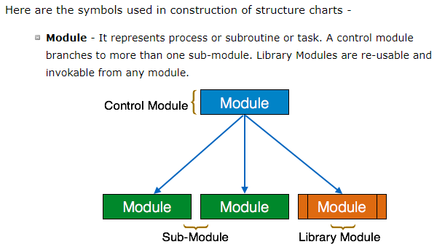

Slide 127
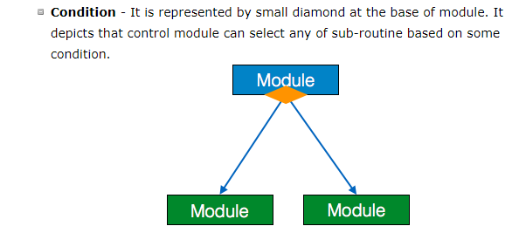

Slide 128
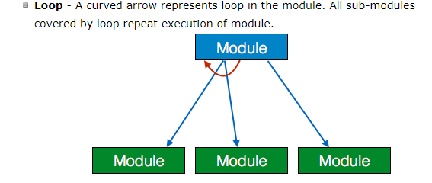

Slide 129
Structure Chart vs. Flow Chart
We are all familiar with the flow chart representation of a program. Flow chart is a convenient technique to represent the flow of control in a program. A structure chart differs from a flow chart in three principal ways:
  • It is usually difficult to identify the different modules of the software from its flow chart representation.
  • Data interchange among different modules is not represented in a flow chart.
  • Sequential ordering of tasks inherent in a flow chart is suppressed in a structure chart.

Slide 130
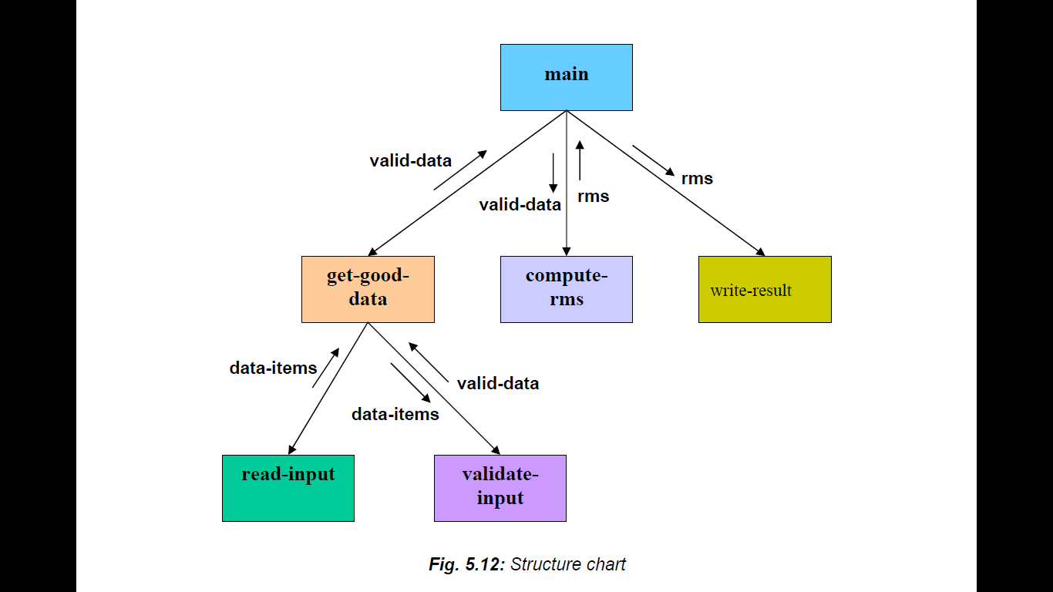
Example: Structure chart for the RMS software

